Slide 1
Classification

Slide 2
Classification: Definition
Given a collection of records (training set )
Each record contains a set of attributes, one of the attributes is the class.
Find a model for class attribute as a function of the values of other attributes.
Goal: previously unseen records should be assigned a class as accurately as possible.
A test set is used to determine the accuracy of the model. Usually, the given data set is divided into training and test sets, with training set used to build the model and test set used to validate it.

Slide 3
Classification Task

Slide 4

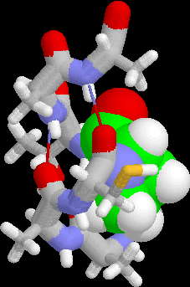
Examples of Classification Task
Classifying credit card transactions as legitimate or fraudulent
Classifying secondary structures of protein as alpha-helix, beta-sheet, or random coil
Categorizing news stories as finance, weather, entertainment, sports, etc

Slide 5
Classification Techniques
Decision Tree based Methods
Rule-based Methods
Memory based reasoning
Neural Networks
Naïve Bayes and Bayesian Belief Networks
Support Vector Machines

Slide 6
Decision Trees

Slide 7
Example of a Decision Tree
categorical
categorical
continuous
class
Splitting Attributes
Refund
Yes
No
NO
MarSt
Single, Divorced
Married
TaxInc
NO
< 80K
> 80K
NO
YES
Training Data
Model: Decision Tree

Slide 8
Another Example of Decision Tree
categorical
categorical
continuous
class
MarSt
Single, Divorced
Married
NO
Refund
Yes
No
NO
TaxInc
< 80K
> 80K
NO
YES
There could be more than one tree that fits the same data!

Slide 9
Decision Tree Classification Task
Decision Tree

Slide 10
Apply Model to Test Data
Test Data
Start from the root of tree.
Refund
Yes
No
NO
MarSt
Single, Divorced
Married
TaxInc
NO
< 80K
> 80K
NO
YES

Slide 11
Apply Model to Test Data
Test Data
Refund
Yes
No
NO
MarSt
Single, Divorced
Married
TaxInc
NO
< 80K
> 80K
NO
YES

Slide 12
Apply Model to Test Data
Test Data
Refund
Yes
No
NO
MarSt
Single, Divorced
Married
TaxInc
NO
< 80K
> 80K
NO
YES

Slide 13
Apply Model to Test Data
Test Data
Refund
Yes
No
NO
MarSt
Single, Divorced
Married
TaxInc
NO
< 80K
> 80K
NO
YES

Slide 14
Apply Model to Test Data
Test Data
Refund
Yes
No
NO
MarSt
Single, Divorced
Married
TaxInc
NO
< 80K
> 80K
NO
YES

Slide 15
Apply Model to Test Data
Test Data
Refund
Yes
No
NO
MarSt
Single, Divorced
Married
Assign Cheat to “No”
TaxInc
NO
< 80K
> 80K
NO
YES

Slide 16
Decision Tree Classification Task
Decision Tree

Slide 17
Decision Tree Induction
Many Algorithms:
Hunt’s Algorithm (one of the earliest)
CART
ID3, C4.5
SLIQ,SPRINT

Slide 18
Hunt’s Algorithm
Let D_{t} be the set of training records that reach a node t
General Procedure:
If D_{t} contains records that belong the same class y_{t}, then t is a leaf node labeled as y_{t}
If D_{t} is an empty set, then t is a leaf node labeled by the default class, y_{d}
If D_{t} contains records that belong to more than one class, use an attribute test to split the data into smaller subsets. Recursively apply the procedure to each subset.
D_{t}
?

Slide 19
Hunt’s Algorithm
Refund
Don’t
Cheat
Yes
No
Don’t
Cheat
Don’t
Cheat
Refund
Refund
Yes
No
Yes
No
Don’t
Cheat
Marital
Status
Don’t
Cheat
Marital
Status
Single,
Divorced
Single,
Divorced
Married
Married
Cheat
Don’t
Cheat
Taxable
Income
Don’t
Cheat
< 80K
>= 80K
Don’t
Cheat
Cheat

Slide 20
Tree Induction
Greedy strategy.
Split the records based on an attribute test that optimizes certain criterion.
Issues
Determine how to split the records
How to specify the attribute test condition?
How to determine the best split?
Determine when to stop splitting

Slide 21
Tree Induction
Greedy strategy.
Split the records based on an attribute test that optimizes certain criterion.
Issues
Determine how to split the records
How to specify the attribute test condition?
How to determine the best split?
Determine when to stop splitting

Slide 22
How to Specify Test Condition?
Depends on attribute types
Nominal
Ordinal
Continuous
Depends on number of ways to split
2-way split
Multi-way split

Slide 23
Splitting Based on Nominal Attributes
Multi-way split: Use as many partitions as distinct values.
Binary split: Divides values into two subsets. Need to find optimal partitioning.
CarType
Family
Luxury
Sports
CarType
CarType
{Sports, Luxury}
OR
{Family, Luxury}
{Family}
{Sports}

Slide 24
Splitting Ordinal Attributes
Multi-way split: Use as many partitions as distinct values.
Binary split: Divides values into two subsets. Need to find optimal partitioning.
What about this split?
Size
Small
Large
Medium
Size
Size
{Small, Medium}
OR
{Medium, Large}
{Large}
{Small}
Size
{Small, Large}
{Medium}

Slide 25
Splitting Based on Continuous Attributes
Different ways of handling
Discretization to form an ordinal categorical attribute
Static – discretize once at the beginning
Dynamic – ranges can be found by equal interval bucketing, equal frequency bucketing (percentiles), or clustering.
Binary Decision: (A < v) or (A ≥ v)
consider all possible splits and finds the best cut
can be more compute intensive

Slide 26
Splitting Based on Continuous Attributes

Slide 27
Tree Induction
Greedy strategy.
Split the records based on an attribute test that optimizes certain criterion.
Issues
Determine how to split the records
How to specify the attribute test condition?
How to determine the best split?
Determine when to stop splitting

Slide 28
How to determine the Best Split
Before Splitting: 10 records of class 0, 10 records of class 1
Which test condition is the best?

Slide 29
How to determine the Best Split
Greedy approach:
Nodes with homogeneous class distribution are preferred
Need a measure of node impurity:
Non-homogeneous,
High degree of impurity
Homogeneous,
Low degree of impurity

Slide 30
Measures of Node Impurity
Gini Index
Entropy
Misclassification error

Slide 31
How to Find the Best Split
Before Splitting:
M0
A?
B?
Yes
No
Yes
No
Node N1
Node N2
Node N3
Node N4
M1
M2
M3
M4
M12
M34
Gain = M0 – M12 vs M0 – M34

Slide 32
Measure of Impurity: GINI
Gini Index for a given node t :
(NOTE: p( j | t) is the relative frequency of class j at node t).
Maximum (1 - 1/n_{c}) when records are equally distributed among all classes, implying least interesting information
Minimum (0.0) when all records belong to one class, implying most interesting information

Slide 33
Examples for computing GINI
P(C1) = 0/6 = 0 P(C2) = 6/6 = 1
Gini = 1 – P(C1)² – P(C2)² = 1 – 0 – 1 = 0
P(C1) = 1/6 P(C2) = 5/6
Gini = 1 – (1/6)² – (5/6)² = 0.278
P(C1) = 2/6 P(C2) = 4/6
Gini = 1 – (2/6)² – (4/6)² = 0.444

Slide 34
Splitting Based on GINI
Used in CART, SLIQ, SPRINT.
When a node p is split into k partitions (children), the quality of split is computed as,
where, n_{i} = number of records at child i,
n = number of records at node p.

Slide 35
Binary Attributes: Computing GINI Index
Splits into two partitions
Effect of Weighing partitions:
Larger and Purer Partitions are sought for.
B?
Yes
No
Node N1
Node N2
Gini(N1) = 1 – (5/6)² – (2/6)² = 0.194
Gini(N2) = 1 – (1/6)² – (4/6)² = 0.528
Gini(Children) = 7/12 * 0.194 + 5/12 * 0.528 = 0.333

Slide 36
Categorical Attributes: Computing Gini Index
For each distinct value, gather counts for each class in the dataset
Use the count matrix to make decisions
Multi-way split
Two-way split
(find best partition of values)

Slide 37
Continuous Attributes: Computing Gini Index
Use Binary Decisions based on one value
Several Choices for the splitting value
Number of possible splitting values = Number of distinct values
Each splitting value has a count matrix associated with it
Class counts in each of the partitions, A < v and A ≥ v
Simple method to choose best v
For each v, scan the database to gather count matrix and compute its Gini index
Computationally Inefficient! Repetition of work.

Slide 38
Continuous Attributes: Computing Gini Index...
For efficient computation: for each attribute,
Sort the attribute on values
Linearly scan these values, each time updating the count matrix and computing gini index
Choose the split position that has the least gini index
Sorted Values
Split Positions

Slide 39
Alternative Splitting Criteria based on INFO
Entropy at a given node t:
(NOTE: p( j | t) is the relative frequency of class j at node t).
Measures homogeneity of a node.
Maximum (log n_{c}) when records are equally distributed among all classes implying least information
Minimum (0.0) when all records belong to one class, implying most information
Entropy based computations are similar to the GINI index computations

Slide 40
Examples for computing Entropy
P(C1) = 0/6 = 0 P(C2) = 6/6 = 1
Entropy = – 0 log 0 – 1 log 1 = – 0 – 0 = 0
P(C1) = 1/6 P(C2) = 5/6
Entropy = – (1/6) log₂ (1/6) – (5/6) log₂ (1/6) = 0.65
P(C1) = 2/6 P(C2) = 4/6
Entropy = – (2/6) log₂ (2/6) – (4/6) log₂ (4/6) = 0.92

Slide 41
Splitting Based on INFO...
Information Gain:
Parent Node, p is split into k partitions;
n_{i} is number of records in partition i
Measures Reduction in Entropy achieved because of the split. Choose the split that achieves most reduction (maximizes GAIN)
Used in ID3 and C4.5
Disadvantage: Tends to prefer splits that result in large number of partitions, each being small but pure.

Slide 42
Splitting Based on INFO...
Gain Ratio:
Parent Node, p is split into k partitions
n_{i} is the number of records in partition i
Adjusts Information Gain by the entropy of the partitioning (SplitINFO). Higher entropy partitioning (large number of small partitions) is penalized!
Used in C4.5
Designed to overcome the disadvantage of Information Gain

Slide 43
Splitting Criteria based on Classification Error
Classification error at a node t :
Measures misclassification error made by a node.
Maximum (1 - 1/n_{c}) when records are equally distributed among all classes, implying least interesting information
Minimum (0.0) when all records belong to one class, implying most interesting information

Slide 44
Examples for Computing Error
P(C1) = 0/6 = 0 P(C2) = 6/6 = 1
Error = 1 – max (0, 1) = 1 – 1 = 0
P(C1) = 1/6 P(C2) = 5/6
Error = 1 – max (1/6, 5/6) = 1 – 5/6 = 1/6
P(C1) = 2/6 P(C2) = 4/6
Error = 1 – max (2/6, 4/6) = 1 – 4/6 = 1/3

Slide 45
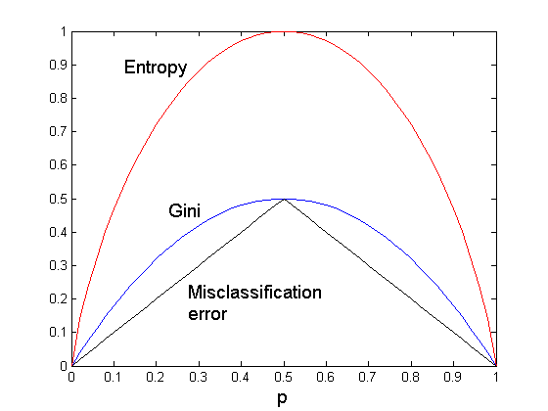
Comparison among Splitting Criteria
For a 2-class problem:

Slide 46
Tree Induction
Greedy strategy.
Split the records based on an attribute test that optimizes certain criterion.
Issues
Determine how to split the records
How to specify the attribute test condition?
How to determine the best split?
Determine when to stop splitting

Slide 47
Stopping Criteria for Tree Induction
Stop expanding a node when all the records belong to the same class
Stop expanding a node when all the records have similar attribute values
Early termination (to be discussed later)

Slide 48
Decision Tree Based Classification
Advantages:
Inexpensive to construct
Extremely fast at classifying unknown records
Easy to interpret for small-sized trees
Accuracy is comparable to other classification techniques for many simple data sets

Slide 49
Example: C4.5
Simple depth-first construction.
Uses Information Gain
Sorts Continuous Attributes at each node.
Needs entire data to fit in memory.
Unsuitable for Large Datasets.
Needs out-of-core sorting.
You can download the software from: http://www.cse.unsw.edu.au/~quinlan/c4.5r8.tar.gz

Slide 50
Practical Issues of Classification
Underfitting and Overfitting
Missing Values
Costs of Classification

Slide 51
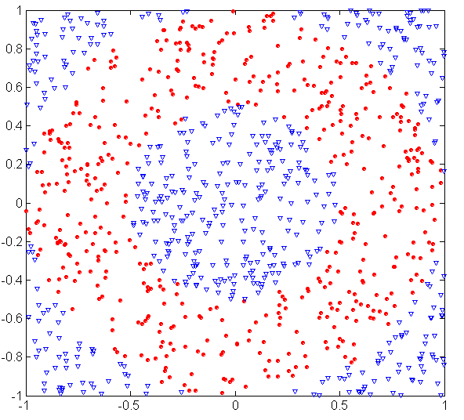
Underfitting and Overfitting (Example)
500 circular and 500 triangular data points.
Circular points:
0.5 ≤ sqrt(x₁²+x₂²) ≤ 1
Triangular points:
sqrt(x₁²+x₂²) > 0.5 or
sqrt(x₁²+x₂²) < 1

Slide 52
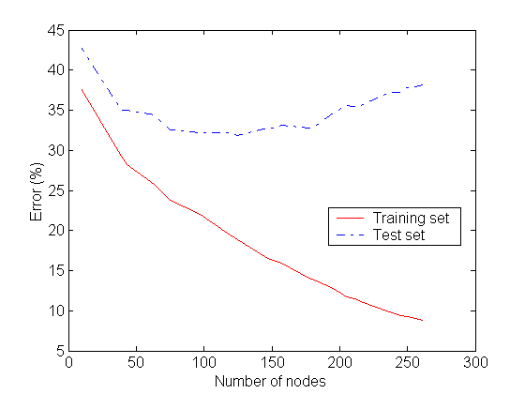
Underfitting and Overfitting
Overfitting
Underfitting: when model is too simple, both training and test errors are large

Slide 53
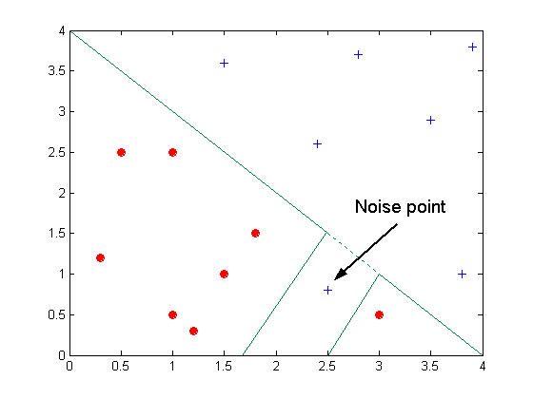
Overfitting due to Noise
Decision boundary is distorted by noise point

Slide 54
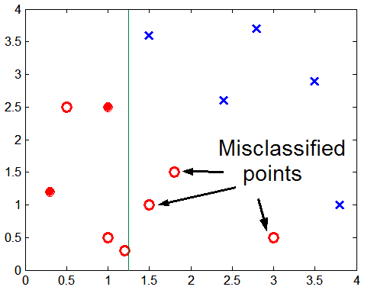
Overfitting due to Insufficient Examples
Lack of data points in the lower half of the diagram makes it difficult to predict correctly the class labels of that region
- Insufficient number of training records in the region causes the decision tree to predict the test examples using other training records that are irrelevant to the classification task

Slide 55
Notes on Overfitting
Overfitting results in decision trees that are more complex than necessary
Training error no longer provides a good estimate of how well the tree will perform on previously unseen records
Need new ways for estimating errors

Slide 56
Estimating Generalization Errors
Re-substitution errors: error on training (Σ e(t) )
Generalization errors: error on testing (Σ e’(t))
Methods for estimating generalization errors:
Optimistic approach: e’(t) = e(t)
Pessimistic approach:
For each leaf node: e’(t) = (e(t)+0.5)
Total errors: e’(T) = e(T) + N × 0.5 (N: number of leaf nodes)
For a tree with 30 leaf nodes and 10 errors on training (out of 1000 instances): Training error = 10/1000 = 1%
Generalization error = (10 + 30×0.5)/1000 = 2.5%
Reduced error pruning (REP):
uses validation data set to estimate generalization error

Slide 57
Occam’s Razor
Given two models of similar generalization errors, one should prefer the simpler model over the more complex model
For complex models, there is a greater chance that it was fitted accidentally by errors in data
Therefore, one should include model complexity when evaluating a model

Slide 58
Minimum Description Length (MDL)
Cost(Model,Data) = Cost(Data|Model) + Cost(Model)
Cost is the number of bits needed for encoding.
Search for the least costly model.
Cost(Data|Model) encodes the misclassification errors.
Cost(Model) uses node encoding (number of children) plus splitting condition encoding.

Slide 59
How to Address Overfitting
Pre-Pruning (Early Stopping Rule)
Stop the algorithm before it becomes a fully-grown tree
Typical stopping conditions for a node:
Stop if all instances belong to the same class
Stop if all the attribute values are the same
More restrictive conditions:
Stop if number of instances is less than some user-specified threshold
Stop if class distribution of instances are independent of the available features (e.g., using χ ² test)
Stop if expanding the current node does not improve impurity measures (e.g., Gini or information gain).

Slide 60
How to Address Overfitting…
Post-pruning
Grow decision tree to its entirety
Trim the nodes of the decision tree in a bottom-up fashion
If generalization error improves after trimming, replace sub-tree by a leaf node.
Class label of leaf node is determined from majority class of instances in the sub-tree
Can use MDL for post-pruning

Slide 61
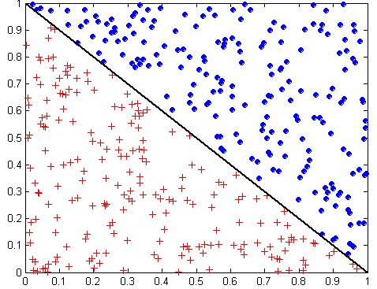
Oblique Decision Trees
x + y < 1
Class = +
Class =
Test condition may involve multiple attributes
More expressive representation
Finding optimal test condition is computationally expensive

Slide 62
Model Evaluation
Metrics for Performance Evaluation
How to evaluate the performance of a model?
Methods for Performance Evaluation
How to obtain reliable estimates?
Methods for Model Comparison
How to compare the relative performance among competing models?

Slide 63
Model Evaluation
Metrics for Performance Evaluation
How to evaluate the performance of a model?
Methods for Performance Evaluation
How to obtain reliable estimates?
Methods for Model Comparison
How to compare the relative performance among competing models?

Slide 64
Metrics for Performance Evaluation
Focus on the predictive capability of a model
Rather than how fast it takes to classify or build models, scalability, etc.
Confusion Matrix:
 | PREDICTED CLASS
ACTUAL CLASS |  | Class=Yes | Class=No
 | Class=Yes | a | b
 | Class=No | c | d
a: TP (true positive)
b: FN (false negative)
c: FP (false positive)
d: TN (true negative)

Slide 65
Metrics for Performance Evaluation…
Most widely-used metric:
 | PREDICTED CLASS
ACTUAL CLASS |  | Class=Yes | Class=No
 | Class=Yes | a (TP) | b (FN)
 | Class=No | c (FP) | d (TN)

Slide 66
Limitation of Accuracy
Consider a 2-class problem
Number of Class 0 examples = 9990
Number of Class 1 examples = 10
If model predicts everything to be class 0, accuracy is 9990/10000 = 99.9 %
Accuracy is misleading because model does not detect any class 1 example

Slide 67
Cost Matrix
 | PREDICTED CLASS
ACTUAL CLASS | C(i|j) | Class=Yes | Class=No
 | Class=Yes | C(Yes|Yes) | C(No|Yes)
 | Class=No | C(Yes|No) | C(No|No)
C(i|j): Cost of misclassifying class j example as class i

Slide 68
Cost-Sensitive Measures
Precision is biased towards C(Yes|Yes) & C(Yes|No)
Recall is biased towards C(Yes|Yes) & C(No|Yes)
F-measure is biased towards all except C(No|No)

Slide 69
Model Evaluation
Metrics for Performance Evaluation
How to evaluate the performance of a model?
Methods for Performance Evaluation
How to obtain reliable estimates?
Methods for Model Comparison
How to compare the relative performance among competing models?

Slide 70
Methods for Performance Evaluation
How to obtain a reliable estimate of performance?
Performance of a model may depend on other factors besides the learning algorithm:
Class distribution
Cost of misclassification
Size of training and test sets

Slide 71
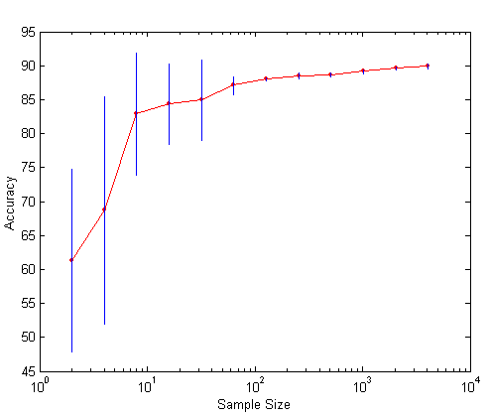
Learning Curve
Learning curve shows how accuracy changes with varying sample size
Requires a sampling schedule for creating learning curve:
Arithmetic sampling (Langley, et al)
Geometric sampling (Provost et al)
Effect of small sample size:
Bias in the estimate
Variance of estimate

Slide 72
Methods of Estimation
Holdout
Reserve 2/3 for training and 1/3 for testing
Random subsampling
Repeated holdout
Cross validation
Partition data into k disjoint subsets
k-fold: train on k-1 partitions, test on the remaining one
Leave-one-out: k=n
Stratified sampling
oversampling vs undersampling
Bootstrap
Sampling with replacement

Slide 73
Model Evaluation
Metrics for Performance Evaluation
How to evaluate the performance of a model?
Methods for Performance Evaluation
How to obtain reliable estimates?
Methods for Model Comparison
How to compare the relative performance among competing models?

Slide 74
ROC (Receiver Operating Characteristic)
Developed in 1950s for signal detection theory to analyze noisy signals
Characterize the trade-off between positive hits and false alarms
ROC curve plots TP (on the y-axis) against FP (on the x-axis)
Performance of each classifier represented as a point on the ROC curve
changing the threshold of algorithm, sample distribution or cost matrix changes the location of the point

Slide 75
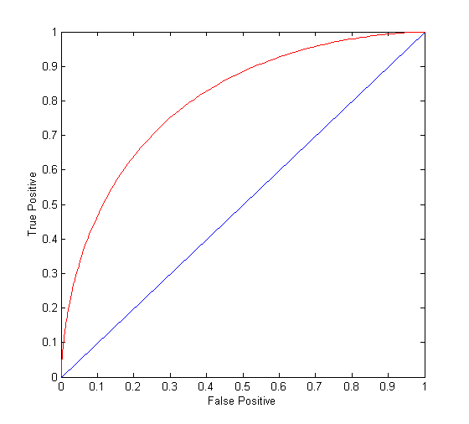
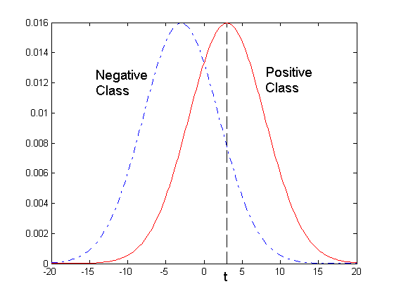
ROC Curve
- 1-dimensional data set containing 2 classes (positive and negative)
- any points located at x > t is classified as positive
At threshold t:
TP=0.5, FN=0.5, FP=0.12, FN=0.88

Slide 76
ROC Curve
(TP,FP):
(0,0): declare everything to be negative class
(1,1): declare everything to be positive class
(1,0): ideal
Diagonal line:
Random guessing
Below diagonal line:
prediction is opposite of the true class

Slide 77
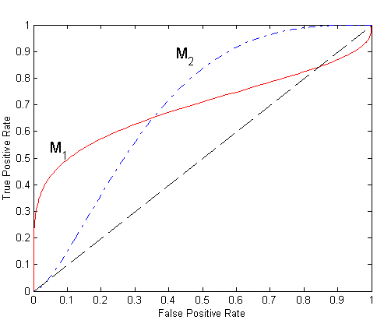
Using ROC for Model Comparison
No model consistently outperform the other
M₁ is better for small FPR
M₂ is better for large FPR
Area Under the ROC curve
Ideal:
Area = 1
Random guess:
Area = 0.5

Slide 78
Test of Significance
Given two models:
Model M1: accuracy = 85%, tested on 30 instances
Model M2: accuracy = 75%, tested on 5000 instances
Can we say M1 is better than M2?
How much confidence can we place on accuracy of M1 and M2?
Can the difference in performance measure be explained as a result of random fluctuations in the test set?

Slide 79
Comparing Performance of 2 Models
Given two models, say M1 and M2, which is better?
M1 is tested on D1 (size=n1), found error rate = e₁
M2 is tested on D2 (size=n2), found error rate = e₂
Assume D1 and D2 are independent
If n1 and n2 are sufficiently large, then
Approximate:

Slide 80
Comparing Performance of 2 Models
To test if performance difference is statistically significant: d = e1 – e2
d ~ N(d_{t},σ_{t}) where d_{t} is the true difference
Since D1 and D2 are independent, their variance adds up:
At (1-α) confidence level,

Slide 81
Bayesian Classification

Slide 82


A Simple Species Classification Problem
Measure the length of a fish, and decide its class
Hilsa or Tuna

Slide 83


Collect Statistics …
Population for Class Hilsa
Population for Class Tuna

Slide 84
Distribution of “Fish Length”
Class Conditional Distributions
P ( L = 1.75 ft | HILSA )
P ( L = 4.25 ft | TUNA )
HILSA
Count/probability
length in feet
1ft
TUNA
Count/probability
Histograms
length in feet
4ft

Slide 85
Decision Rule
If length L ≤ B
HILSA
ELSE
TUNA
What should be the value of B (“boundary” length) ?
Based on population statistics

Slide 86
Error of Decision Rule
P( L | TUNA)
P( L | HILSA)
L
B
Errors: Type 1 + Type 2,
Type 1: Actually Tuna, Classified as Hilsa (area under pink curve to the left of a B)
Type 2: Actually Hilsa, Classified as Tuna (area under blue curve to the right of a B)

Slide 87
Optimal Decision Rule
P( L | TUNA)
P( L | HILSA)
L
B*
B*: Optimal Value of B, (Optimal Decision Boundary)
Minimum Possible Error
P ( B* | HILSA ) = P ( B* | TUNA )
If Type 1 and Type 2 errors have different costs : optimal boundary shifts

Slide 88
Species Identification Problem
Measure lengths of a (sizeable) population of Hilsa and Tuna fishes
Estimate Class Conditional Distributions for Hilsa and Tuna classes respectively
Find Optimal Decision Boundary B* from the distributions
Apply Decision Rule to classify a newly caught (and measured) fish as either Hilsa or Tuna
(with minimum error probability)

Slide 89
Location/Time of Experiment
Calcutta in Monsoon
More Hilsa few Tuna
California in Winter
More Tuna less Hilsa
Even a 2ft fish is likely to be Hilsa in Calcutta (2000 Rs/Kilo!),
a 1.5ft fish may be Tuna in California

Slide 90
Apriori Probability
Without measuring length what can we guess about the class of a fish
Depends on location/time of experiment
Calcutta : Hilsa, California: Tuna
Apriori probability: P(HILSA), P(TUNA)
Property of the frequency of classes during experiment
Not a property of length of the fish
Calcutta: P(Hilsa) = 0.90, P(Tuna) = 0.10
California: P(Tuna) = 0.95, P(Hilsa) = 0.05
London: P(Tuna) = 0.50, P(Hilsa) = 0.50
Also a determining factor in class decision along with class conditional probability

Slide 91
Classification Decision
We consider the product of Apriori and Class conditional probability factors
Posteriori probability (Bayes rule)
P(HILSA | L = 2ft) = P(HILSA) x P(L=2ft | HILSA) / P(L=2ft)
Posteriori ≈ Apriori x Class conditional
denominator is constant for all classes
Apriori: Without any measurement - based on just location/time – what can we guess about class membership (estimated frm size of class populations)
Class conditional: Given the fish belongs to a particular class what is the probability that its length is L=2ft (estimated from population)
Posteriori: Given the measurement that the length of the fish is L=2ft what is the probability that the fish belongs to a particular class (obtained using Bayes rule from above two probabilities).
Useful in decision making using evidences/measurements.

Slide 92
Bayes Classification Rule (Bayes Classifier)
Posteriori Distributions
P( TUNA | L)
P( HILSA | L)
L
B*
B*: Optimal Value of B, (Bayes Decision Boundary)
P ( HILSA| L= B* ) = P ( TUNA | L = B*)
Minimum error probability: Bayes error

Slide 93
MAP Representation of Bayes Classifier
Posteriori Distributions
P( TUNA | L)
P( HILSA | L)
L
Hilsa has higher posteriori probability than Tuna for this length
Instead of finding decision boundary B*, state classification rule as:
Classify an object in to the class for which it has the highest posteriori prob.
(MAP: Maximum Aposteriori Probability)

Slide 94
MAP Multiclass Classifier
Posteriori Distributions
P( TUNA | L)
P( SHARK | L)
P( HILSA | L)
L
Hilsa has highest posteriori probability among all classes for this length
Classify an object in to the class for which it has the highest posteriori prob.
(MAP: Maximum Aposteriori Probability)

Slide 95
Multivariate Bayes Classifier
Decision Boundary
TUNA
Weight
HILSA
Length
Feature or Attribute Space
Class Seperability

Slide 96
Decision Boundary: Normal Distrib.
Two spherical classes having different means, but same variance (diagonal covariance matrix with same variances)
Weight
TUNA
HILSA
Length
Decision Boundary: Perpendicular bisector of the mean vectors

Slide 97
Distances
Two vectors: Euclidean, Minkowski etc
A vector and a distribution: Mahalanobis, Bhattacharya
Between two distributions: Kullback-Liebler Divergence
Which distribution is closer to x?
x
μ
σ₂
σ₁

Slide 98
Decision Boundary
Two spherical classes having different means and variances (diagonal covariance matrix with different variances)
TUNA
Weight
HILSA
Length
Boundary: Locus of equi-Mahalanobis distance points from the
class distributions. (still a straight line)

Slide 99
Decision Boundary
Two elliptical classes having different means and variances (general covariance matrix with different variances)
TUNA
Weight
HILSA
Length
Class Boundary: Parabolic

Slide 100
Bayesian Classifiers
Approach:
compute the posterior probability P(C | A₁, A₂, …, A_{n}) for all values of C using the Bayes theorem
Choose value of C that maximizes P(C | A₁, A₂, …, A_{n})
Equivalent to choosing value of C that maximizes P(A₁, A₂, …, A_{n}|C) P(C)
How to estimate P(A₁, A₂, …, A_{n} | C )?

Slide 101
Estimating Multivariate Distributions
Sample size requirement
In a small sample: difficult to find a Hilsa fish whose length is 1.5ft and weight is 2 kilos, as compared to that of just finding a fish whose length is 1.5ft
P(L=1.5, W=2 | Hilsa), P(L=1.5 | Hilsa)
Curse of dimensionality
Independence Assumption
Assume length and weight are independent
P(L=1.5, W=2 | Hilsa) = P(L=1.5 | Hilsa) x P(W=2| Hilsa)
Joint distribution = product of marginal distributions
Marginals are easier to estimate from a small sample

Slide 102
Naïve Bayes Classifier
Assume independence among attributes A_{i} when class is given:
P(A₁, A₂, …, A_{n} |C) = P(A₁| C_{j}) P(A₂| C_{j})… P(A_{n}| C_{j})
Can estimate P(A_{i}| C_{j}) for all A_{i} and C_{j}.
New point is classified to C_{j} if P(C_{j}) Π P(A_{i}| C_{j}) is maximal.

Slide 103
Example of Naïve Bayes Classifier
A: attributes
M: mammals
N: non-mammals
P(A|M)P(M) > P(A|N)P(N)
=> Mammals

Slide 104
How to Estimate Probabilities from Data?
For continuous attributes:
Discretize the range into bins
one ordinal attribute per bin
violates independence assumption
Two-way split: (A < v) or (A > v)
choose only one of the two splits as new attribute
Probability density estimation:
Assume attribute follows a normal distribution
Use data to estimate parameters of distribution (e.g., mean and standard deviation)
Once probability distribution is known, can use it to estimate the conditional probability P(A_{i}|c)
k

Slide 105
Naïve Bayes Classifier
If one of the conditional probability is zero, then the entire expression becomes zero
Probability estimation:
c: number of classes
p: prior probability
m: parameter

Slide 106
Bayes Classifier (Summary)
Robust to isolated noise points
Handle missing values by ignoring the instance during probability estimate calculations
Robust to irrelevant attributes
Independence assumption may not hold for some attributes
Length and weight of a fish are not independent

Slide 107
Bayesian Belief Network
A directed acyclic probabilistic graphical model that captures dependence among the attributes
Length
Color
Weight
Species
Nodes: Variable/Attributes/Class
Directed edges: Causality
Absence of edge: independence
Network structure: domain knowledge
Joint probabilities: from data

Slide 108
Nonparametric Classifiers
Do not assume parametric data distribution/model
Take decisions based on given sample
Bayesian statistics vs frequentist statistics

Slide 109
Nearest Neighbor Classifiers
Basic idea:
If it walks like a duck, quacks like a duck, then it’s probably a duck
Compute Distance
Test Record
Training Records
Choose k of the “nearest” records

Slide 110
Nearest-Neighbor Classifiers
Requires three things
The set of stored records
Distance Metric to compute distance between records
The value of k, the number of nearest neighbors to retrieve
To classify an unknown record:
Compute distance to other training records
Identify k nearest neighbors
Use class labels of nearest neighbors to determine the class label of unknown record (e.g., by taking majority vote)

Slide 111
Nearest Neighbor Classification
Compute distance between two points:
Euclidean distance
Determine the class from nearest neighbor list
take the majority vote of class labels among the k-nearest neighbors
Weigh the vote according to distance
weight factor, w = 1/d²

Slide 112
Support Vector Machines

Slide 113
Linear Separators
Binary classification can be viewed as the task of separating classes in feature space:
w^{T}x + b = 0
w^{T}x + b > 0
w^{T}x + b < 0
f(x) = sign(w^{T}x + b)

Slide 114
Linear Separators
Which of the linear separators is optimal?

Slide 115
What is a good Decision Boundary?
Many decision boundaries!
The Perceptron algorithm can be used to find such a boundary
Are all decision boundaries equally good?
Class 2
Class 1
Notes:
Perceptron learning rule can be used to find any decision boundary between class 1 and class 2

Slide 116
Examples of Bad Decision Boundaries
Class 2
Class 2
Class 1
Class 1

Slide 117




Finding the Decision Boundary
Let {x₁, ..., x_{n}} be our data set and let y_{i} ∈ {1,-1} be the class label of x_{i}
For y_{i}=1
For y_{i}=-1
y=1
y=1
So:
y=1
y=-1
y=1
y=-1
y=1
Class 2
y=-1
y=-1
y=-1
m
Class 1
y=-1

Slide 118
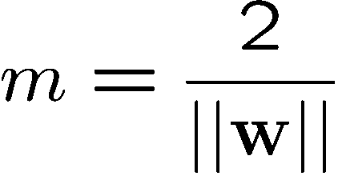
Large-margin Decision Boundary
The decision boundary should be as far away from the data of both classes as possible
We should maximize the margin, m
Class 2
m
Class 1

Slide 119
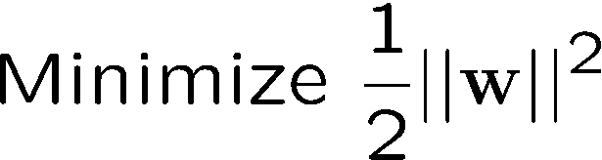
Finding the Decision Boundary
The decision boundary should classify all points correctly ⇒
The decision boundary can be found by solving the following constrained optimization problem
This is a constrained optimization problem. Solving it requires to use Lagrange multipliers

Slide 120
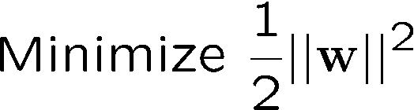
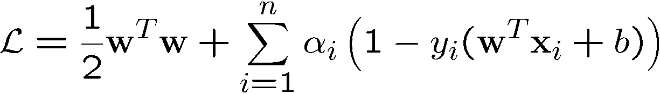
Finding the Decision Boundary
The Lagrangian is
α_{i}≥0
Note that ||w||² = w^{T}w

Slide 121
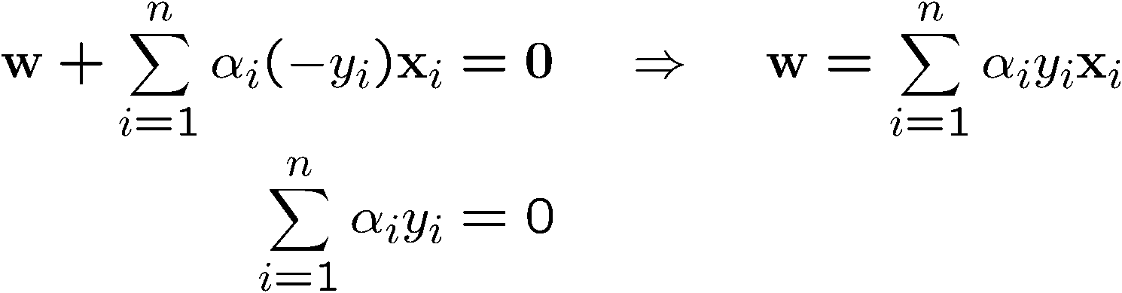
Gradient with respect to w and b
Setting the gradient of w.r.t. w and b to zero, we have
n: no of examples, m: dimension of the space

Slide 122
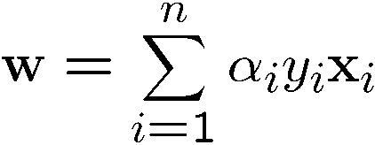

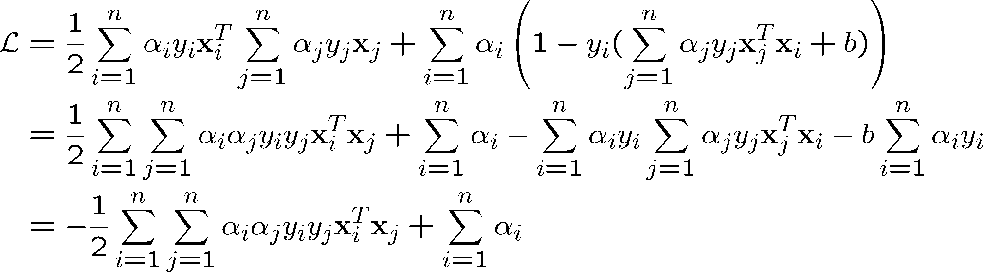
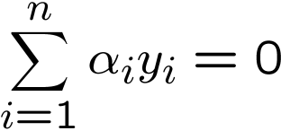
The Dual Problem
If we substitute to , we have
Since
This is a function of α_{i} only

Slide 123
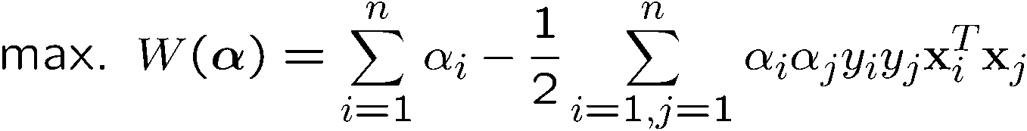
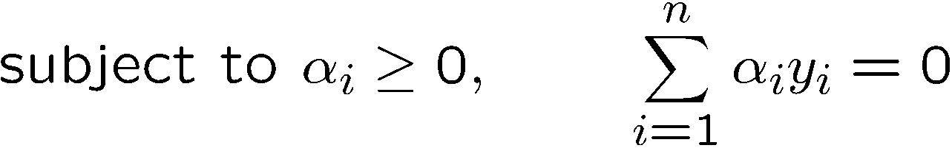
The Dual Problem
The new objective function is in terms of α_{i} only
It is known as the dual problem: if we know w, we know all α_{i}; if we know all α_{i}, we know w
The original problem is known as the primal problem
The objective function of the dual problem needs to be maximized (comes out from the KKT theory)
The dual problem is therefore:
Properties of α_{i} when we introduce the Lagrange multipliers
The result when we differentiate the original Lagrangian w.r.t. b

Slide 124
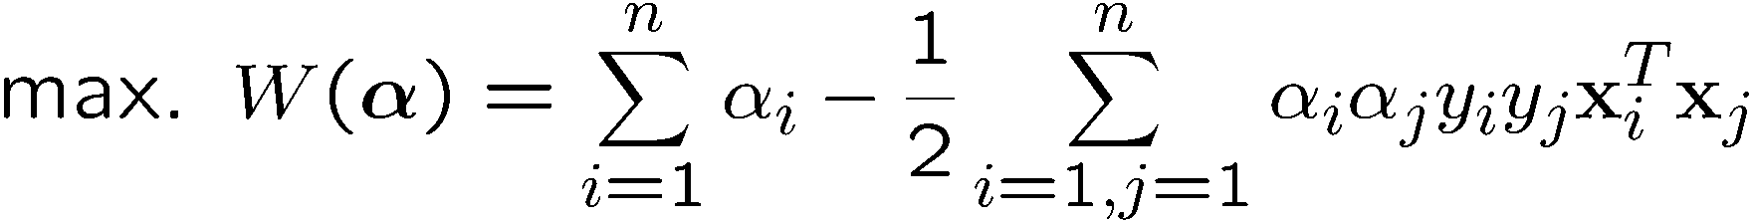
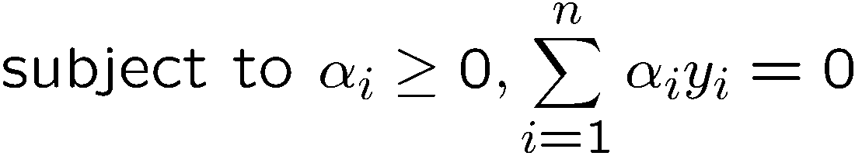
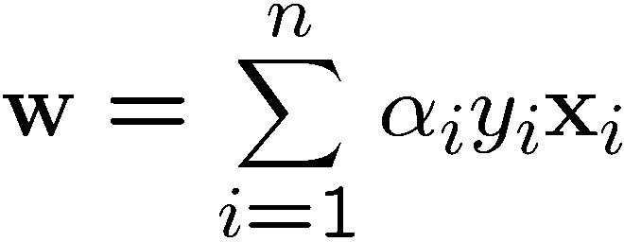
The Dual Problem
This is a quadratic programming (QP) problem
A global maximum of α_{i} can always be found
w can be recovered by
Notes:
Let x(1) and x(-1) be two S.V.
Then b = -1/2( w^T x(1) + w^T x(-1) )

Slide 125
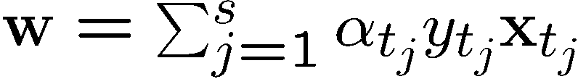
Characteristics of the Solution
Many of the α_{i} are zero
w is a linear combination of a small number of data points
This “sparse” representation can be viewed as data compression as in the construction of knn classifier
x_{i} with non-zero α_{i} are called support vectors (SV)
The decision boundary is determined only by the SV
Let t_{j} (j=1, ..., s) be the indices of the s support vectors. We can write
Note: w need not be formed explicitly

Slide 126




A Geometrical Interpretation
Class 2
α₁₀=0
α₈=0.6
α₇=0
α₂=0
α₅=0
α₁=0.8
α₄=0
α₆=1.4
α₉=0
α₃=0
Class 1
Notes:
So, if change internal points, no effect on the decision boundary

Slide 127
Characteristics of the Solution
For testing with a new data z
Compute and classify z as class 1 if the sum is positive, and class 2 otherwise
Note: w need not be formed explicitly

Slide 128
The Quadratic Programming Problem
Many approaches have been proposed
Loqo, cplex, etc. (see http://www.numerical.rl.ac.uk/qp/qp.html)
Most are “interior-point” methods
Start with an initial solution that can violate the constraints
Improve this solution by optimizing the objective function and/or reducing the amount of constraint violation
For SVM, sequential minimal optimization (SMO) seems to be the most popular
A QP with two variables is trivial to solve
Each iteration of SMO picks a pair of (α_{i},α_{j}) and solve the QP with these two variables; repeat until convergence
In practice, we can just regard the QP solver as a “black-box” without bothering how it works

Slide 129








Non-linearly Separable Problems
We allow “error” ξ_{i} in classification; it is based on the output of the discriminant function w^{T}x+b
ξ_{i} approximates the number of misclassified samples
Class 2
Class 1

Slide 130
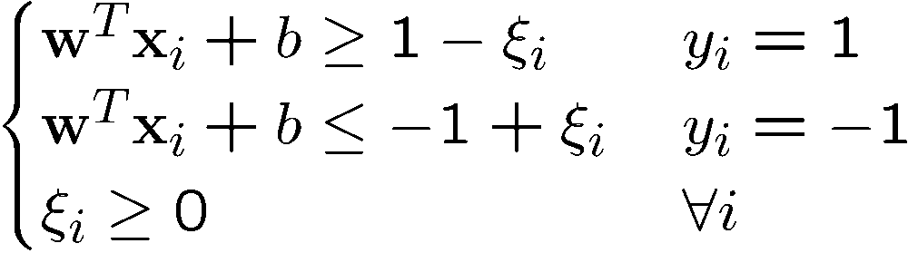
Soft Margin Hyperplane
The new conditions become
ξ_{i} are “slack variables” in optimization
Note that ξ_{i}=0 if there is no error for x_{i}
ξ_{i} is an upper bound of the number of errors
We want to minimize
C : tradeoff parameter between error and margin

Slide 131
The Optimization Problem
With α and μ Lagrange multipliers, POSITIVE
Notes:
Note also, everything is done by inner-products

Slide 132
The Dual Problem
With
Notes:
Note also, everything is done by inner-products

Slide 133
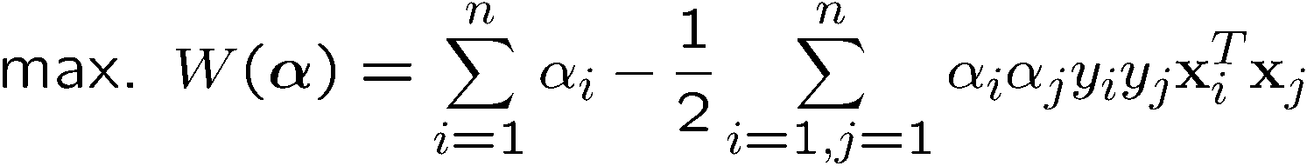
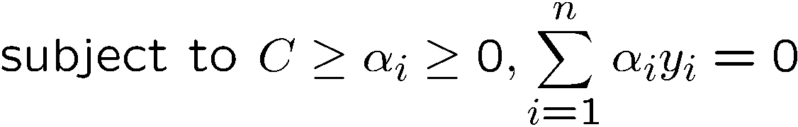
The Optimization Problem
The dual of this new constrained optimization problem is
New constrainsderive from since μ and α are positive.
w is recovered as
This is very similar to the optimization problem in the linear separable case, except that there is an upper bound C on α_{i} now
Once again, a QP solver can be used to find α_{i}
Notes:
Note also, everything is done by inner-products

Slide 134
The algorithm try to keep ξ null, maximising the margin
The algorithm does not minimise the number of error. Instead, it minimises the sum of distances fron the hyperplane
When C increases the number of errors tend to lower. At the limit of C tending to infinite, the solution tend to that given by the hard margin formulation, with 0 errors

Slide 135
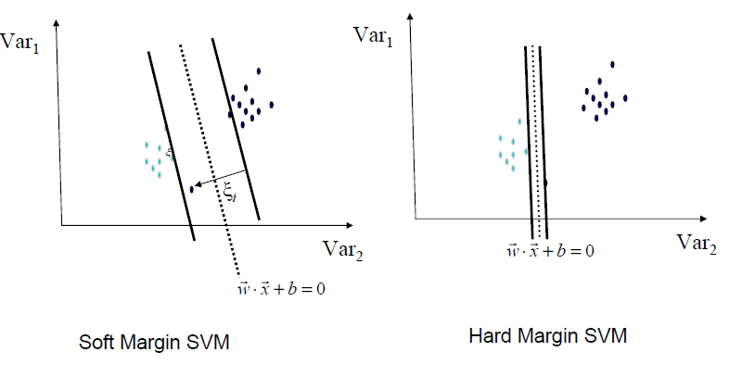
Soft margin is more robust

Slide 136
Extension to Non-linear Decision Boundary
So far, we have only considered large-margin classifier with a linear decision boundary
How to generalize it to become nonlinear?
Key idea: transform x_{i} to a higher dimensional space to “make life easier”
Input space: the space the point x_{i} are located
Feature space: the space of φ(x_{i}) after transformation
Why transform?
Linear operation in the feature space is equivalent to non-linear operation in input space
Classification can become easier with a proper transformation. In the XOR problem, for example, adding a new feature of x₁x₂ make the problem linearly separable
Notes:
XOR: x_1, x_2, and we want to transform to x_1^2, x_2^2, x_1 x_2
It can also be viewed as feature extraction from the feature vector x, but now we extract more feature than the number of features in x.

Slide 137
XOR
Is not linearly separable
X | Y
0 | 0 | 0
0 | 1 | 1
1 | 0 | 1
1 | 1 | 0
Is linearly separable
X | Y | XY
0 | 0 | 0 | 0
0 | 1 | 0 | 1
1 | 0 | 0 | 1
1 | 1 | 1 | 0

Slide 138
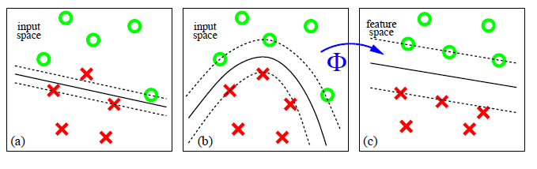
Find a feature space

Slide 139
Transforming the Data
φ( )
φ( )
φ( )
φ( )
φ( )
φ(.)
φ( )
φ( )
φ( )
φ( )
φ( )
φ( )
φ( )
φ( )
φ( )
φ( )
φ( )
φ( )
φ( )
Input space
Feature space
Note: feature space is of higher dimension than the input space in practice
Computation in the feature space can be costly because it is high dimensional
The feature space is typically infinite-dimensional!
The kernel trick comes to rescue

Slide 140
Transforming the Data
φ( )
φ( )
φ( )
φ( )
φ( )
φ(.)
φ( )
φ( )
φ( )
φ( )
φ( )
φ( )
φ( )
φ( )
φ( )
φ( )
φ( )
φ( )
φ( )
Input space
Feature space
Note: feature space is of higher dimension than the input space in practice
Computation in the feature space can be costly because it is high dimensional
The feature space is typically infinite-dimensional!
The kernel trick comes to rescue

Slide 141


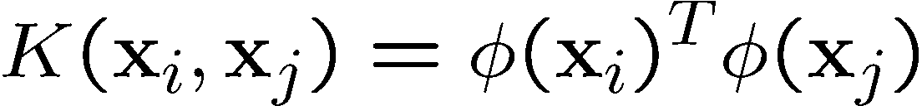
The Kernel Trick
Recall the SVM optimization problem
The data points only appear as inner product
As long as we can calculate the inner product in the feature space, we do not need the mapping explicitly
Many common geometric operations (angles, distances) can be expressed by inner products
Define the kernel function K by

Slide 142
An Example for φ(.) and K(.,.)
Suppose φ(.) is given as follows
An inner product in the feature space is
So, if we define the kernel function as follows, there is no need to carry out φ(.) explicitly
This use of kernel function to avoid carrying out φ(.) explicitly is known as the kernel trick

Slide 143
Kernels
Given a mapping:
a kernel is represented as the inner product
A kernel must satisfy the Mercer’s condition:

Slide 144
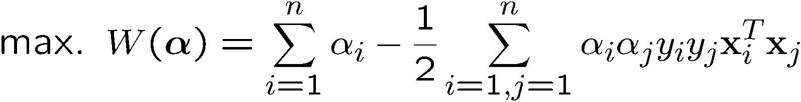

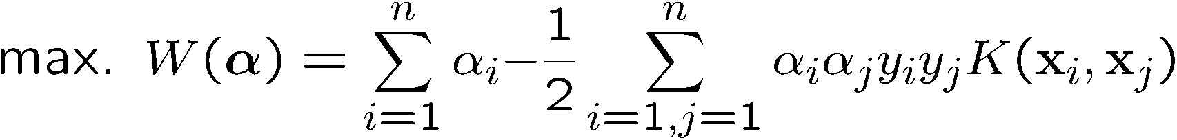
Modification Due to Kernel Function
Change all inner products to kernel functions
For training,
Original
With kernel function

Slide 145
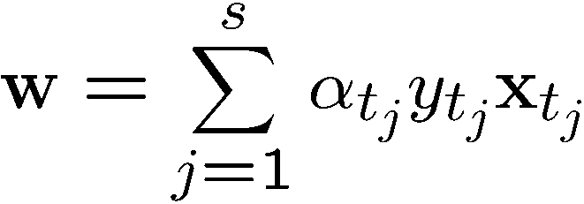
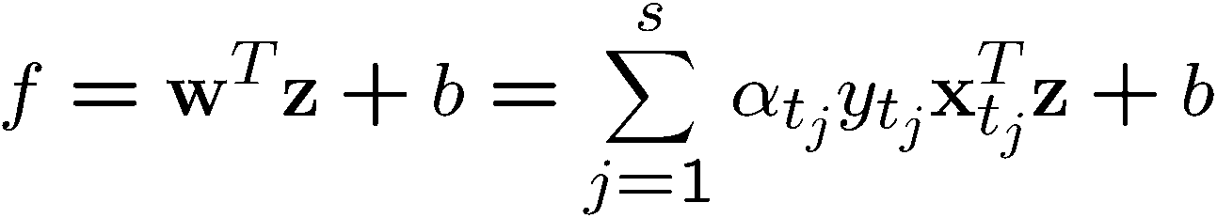
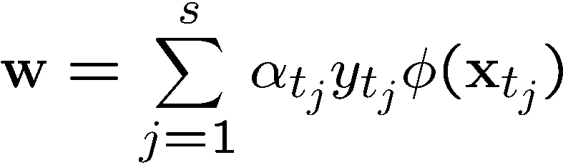
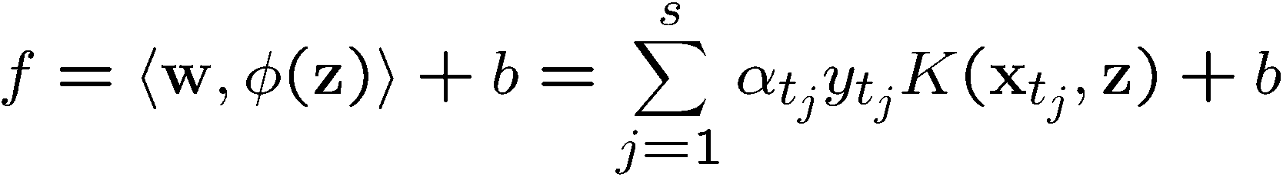
Modification Due to Kernel Function
For testing, the new data z is classified as class 1 if f ≥0, and as class 2 if f <0
Original
With kernel function

Slide 146
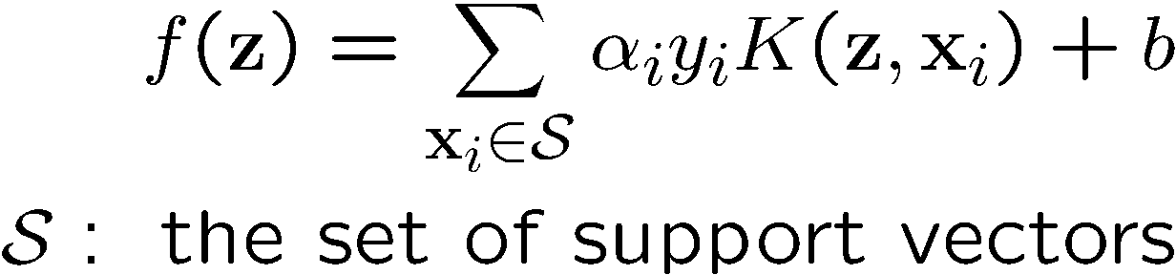
More on Kernel Functions
Since the training of SVM only requires the value of K(x_{i}, x_{j}), there is no restriction of the form of x_{i} and x_{j}
x_{i} can be a sequence or a tree, instead of a feature vector
K(x_{i}, x_{j}) is just a similarity measure comparing x_{i} and x_{j}
For a test object z, the discriminant function essentially is a weighted sum of the similarity between z and a pre-selected set of objects (the support vectors)

Slide 147
Example
Suppose we have 5 1D data points
x₁=1, x₂=2, x₃=4, x₄=5, x₅=6, with 1, 2, 6 as class 1 and 4, 5 as class 2 ⇒ y₁=1, y₂=1, y₃=-1, y₄=-1, y₅=1
Notes:
H =
4 9 -25 -36 49
9 25 -81 -121 169
-25 -81 289 441 -625
-36 -121 441 676 -961
49 169 -625 -961 1369

Slide 148
Example
class 1
class 2
class 1
1
2
4
5
6

Slide 149
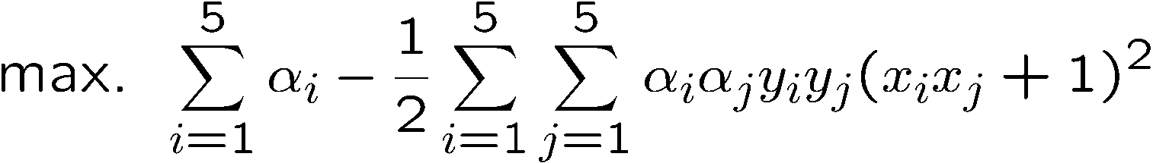
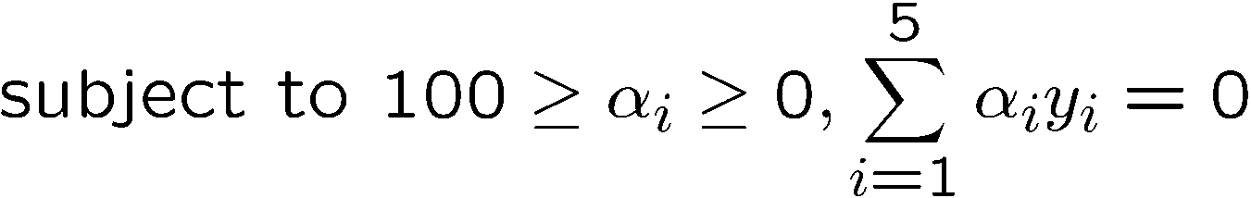
Example
We use the polynomial kernel of degree 2
K(x,y) = (xy+1)²
C is set to 100
We first find α_{i} (i=1, …, 5) by
Notes:
H =
4 9 -25 -36 49
9 25 -81 -121 169
-25 -81 289 441 -625
-36 -121 441 676 -961
49 169 -625 -961 1369

Slide 150



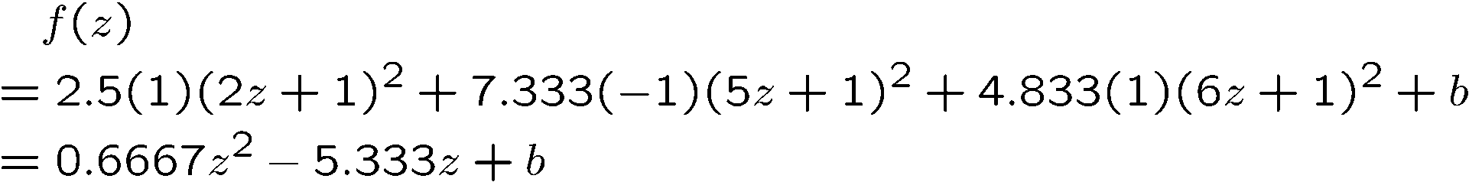
Example
By using a QP solver, we get
α₁=0, α₂=2.5, α₃=0, α₄=7.333, α₅=4.833
Note that the constraints are indeed satisfied
The support vectors are {x₂=2, x₄=5, x₅=6}
The discriminant function is
b is recovered by solving f(2)=1 or by f(5)=-1 or by f(6)=1,
All three give b=9
Notes:
The optimization toolbox of matlab contains a quadratic programming solver

Slide 151
Example
Value of discriminant function
class 1
class 2
class 1
1
2
4
5
6

Slide 152
Kernel Functions
In practical use of SVM, the user specifies the kernel function; the transformation φ(.) is not explicitly stated
Given a kernel function K(x_{i}, x_{j}), the transformation φ(.) is given by its eigenfunctions (a concept in functional analysis)
Eigenfunctions can be difficult to construct explicitly
This is why people only specify the kernel function without worrying about the exact transformation
Another view: kernel function, being an inner product, is really a similarity measure between the objects

Slide 153
A kernel is associated to a transformation
Given a kernel, in principle it should be recovered the transformation in the feature space that originates it.
K(x,y) = (xy+1)²= x²y²+2xy+1
It corresponds the transformation

Slide 154
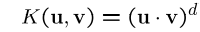

Examples of Kernel Functions
Polynomial kernel up to degree d
Polynomial kernel up to degree d
Radial basis function kernel with width σ
The feature space is infinite-dimensional
Sigmoid with parameter κ and θ
It does not satisfy the Mercer condition on all κ and θ
Notes:
Despite violating Mercer condition, the sigmoid kernel function can still work

Slide 155
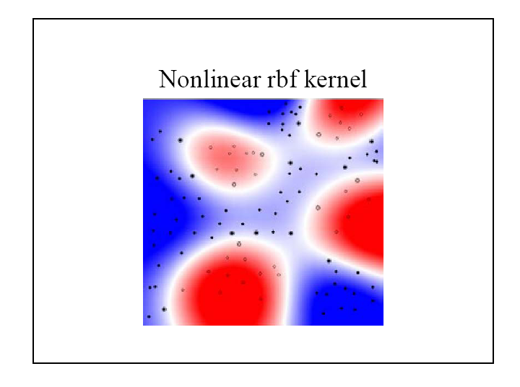
Example
155

Slide 156
Building new kernels
If k₁(x,y) and k₂(x,y) are two valid kernels then the following kernels are valid
Linear Combination
Exponential
Product
Polymomial tranfsormation (Q: polymonial with non negative coeffients)
Function product (f: any function)
Notes:
Despite violating Mercer condition, the sigmoid kernel function can still work

Slide 157
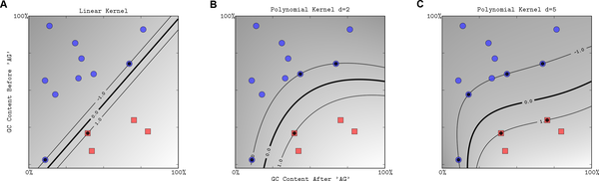
Ploynomial kernel

Slide 158
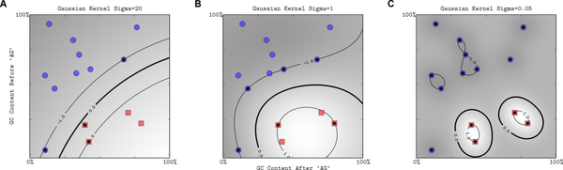
Gaussian RBF kernel

Slide 159
Spectral kernel for sequences
Given a DNA sequence x we can count the number of bases (4-D feature space)
Or the number of dimers (16-D space)
Or l-mers (4^{l} –D space)
The spectral kernel is

Slide 160
Choosing the Kernel Function
Probably the most tricky part of using SVM.
The kernel function is important because it creates the kernel matrix, which summarizes all the data
Many principles have been proposed (diffusion kernel, Fisher kernel, string kernel, …)
There is even research to estimate the kernel matrix from available information
In practice, a low degree polynomial kernel or RBF kernel with a reasonable width is a good initial try
Note that SVM with RBF kernel is closely related to RBF neural networks, with the centers of the radial basis functions automatically chosen for SVM

Slide 161
Other Aspects of SVM
How to use SVM for multi-class classification?
One can change the QP formulation to become multi-class
More often, multiple binary classifiers are combined
See DHS 5.2.2 for some discussion
One can train multiple one-versus-all classifiers, or combine multiple pairwise classifiers “intelligently”
How to interpret the SVM discriminant function value as probability?
By performing logistic regression on the SVM output of a set of data (validation set) that is not used for training
Some SVM software (like libsvm) have these features built-in

Slide 162
Software
A list of SVM implementation can be found at http://www.kernel-machines.org/software.html
Some implementation (such as LIBSVM) can handle multi-class classification
SVMLight is among one of the earliest implementation of SVM
Several Matlab toolboxes for SVM are also available

Slide 163
Summary: Steps for Classification
Prepare the pattern matrix
Select the kernel function to use
Select the parameter of the kernel function and the value of C
You can use the values suggested by the SVM software, or you can set apart a validation set to determine the values of the parameter
Execute the training algorithm and obtain the α_{i}
Unseen data can be classified using the α_{i} and the support vectors

Slide 164
Strengths and Weaknesses of SVM
Strengths
Training is relatively easy
No local optimal, unlike in neural networks
It scales relatively well to high dimensional data
Tradeoff between classifier complexity and error can be controlled explicitly
Non-traditional data like strings and trees can be used as input to SVM, instead of feature vectors
Weaknesses
Need to choose a “good” kernel function.

Slide 165
Conclusion
SVM is a useful alternative to neural networks
Two key concepts of SVM: maximize the margin and the kernel trick
Many SVM implementations are available on the web for you to try on your data set!

Slide 166
Resources
http://www.kernel-machines.org/
http://www.support-vector.net/
http://www.support-vector.net/icml-tutorial.pdf
http://www.kernel-machines.org/papers/tutorial-nips.ps.gz
http://www.clopinet.com/isabelle/Projects/SVM/applist.html

Slide 167
Artificial Neural Networks

Slide 168
Artificial Neural Networks (ANN)
Output Y is 1 if at least two of the three inputs are equal to 1.

Slide 169
Artificial Neural Networks (ANN)

Slide 170
Artificial Neural Networks (ANN)
Model is an assembly of inter-connected nodes and weighted links
Output node sums up each of its input value according to the weights of its links
Compare output node against some threshold t
Perceptron Model
or

Slide 171
General Structure of ANN
Training ANN means learning the weights of the neurons

Slide 172
Algorithm for learning ANN
Initialize the weights (w₀, w₁, …, w_{k})
Adjust the weights in such a way that the output of ANN is consistent with class labels of training examples
Objective function:
Find the weights w_{i}’s that minimize the above objective function
e.g., backpropagation algorithm (see lecture notes)

Slide 173
Many other neural architectures like self organizing maps are used

Slide 174
Ensemble Classifiers

Slide 175
Ensemble Methods
Construct a set of classifiers from the training data
Predict class label of previously unseen records by aggregating predictions made by multiple classifiers

Slide 176
General Idea

Slide 177
Why does it work?
Suppose there are 25 base classifiers
Each classifier has error rate, ε = 0.35
Assume classifiers are independent
Probability that the ensemble classifier makes a wrong prediction:

Slide 178
Examples of Ensemble Methods
How to generate an ensemble of classifiers?
Bagging
Boosting

Slide 179
Bagging
Sampling with replacement
Build classifier on each bootstrap sample
Each sample has probability (1 – 1/n)^{n} of being selected

Slide 180
Boosting
An iterative procedure to adaptively change distribution of training data by focusing more on previously misclassified records
Initially, all N records are assigned equal weights
Unlike bagging, weights may change at the end of boosting round

Slide 181
Boosting
Records that are wrongly classified will have their weights increased
Records that are classified correctly will have their weights decreased
Example 4 is hard to classify
Its weight is increased, therefore it is more likely to be chosen again in subsequent rounds

Slide 182
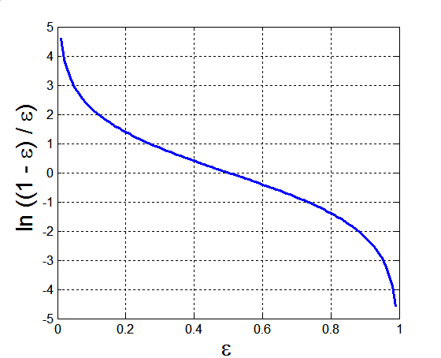
Example: AdaBoost
Base classifiers: C₁, C₂, …, C_{T}
Error rate:
Importance of a classifier:

Slide 183
Example: AdaBoost
Weight update:
If any intermediate rounds produce error rate higher than 50%, the weights are reverted back to 1/n and the resampling procedure is repeated
Classification:

Slide 184
Illustrating AdaBoost
Initial weights for each data point
Data points for training

Slide 185
Illustrating AdaBoost

Slide 186
Thank You!

